Slide 1
Interfacing Stepper motor to 8051 microcontroller
A motor is one which translates electrical pulses into
mechanical motion.
Types of motor are:
Stepper Motor
DC Motor
AC Motor
A stepper motor is a special type of electric motor that moves in increments, or steps, rather than turning smoothly as a conventional motor does.
Typical increments are 0.9 or 1.8 degrees, with 400 or 200 increments thus representing a full circle.
The speed of the motor is determined by the time delay between each incremental movement.
Two types of stepper motor are:
  Permanent Magnet (PM) 2. Variable Reluctance (VR)
Notes:
SBMJCE

Slide 2
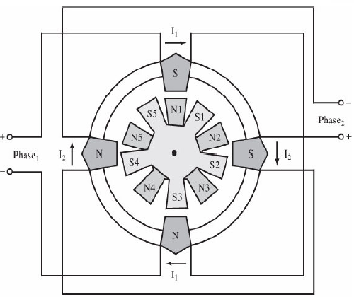

Motor Moves Each Time a Pulse is Received
Can Control Movement (Direction and Amount) Easily
Can Force Motor to Hold Position Against an Opposing Force
Notes:
SBMJCE

Slide 3
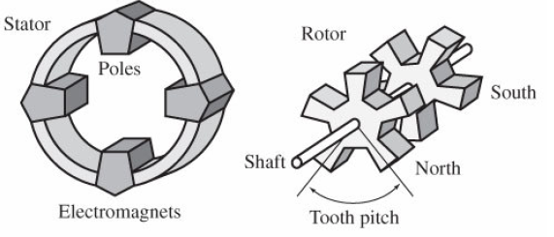

Construction
Permanent Magnet Rotor
  Also Called the Shaft
Stator
  Surrounds the Shaft
  Usually Four Stator Windings Paired with Center-Tapped Common
    Known as Four-Phase or Unipolar Stepper Motor
Notes:
SBMJCE

Slide 4
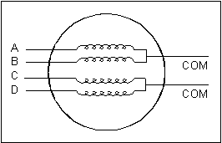
Construction (con’t)
Center Tapped Common
Notes:
SBMJCE

Slide 5
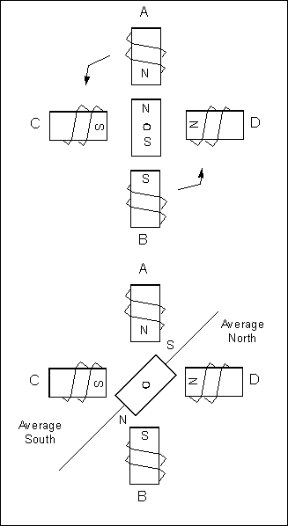
Moving the Rotor
Unstable
Stable
Rotor will ALWAYS seek a stable position.
Notes:
SBMJCE

Slide 6
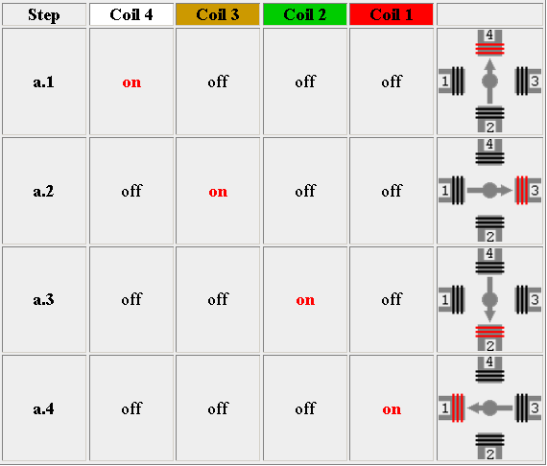
Single-Coil Excitation - Each successive coil is energised in turn.

Slide 7
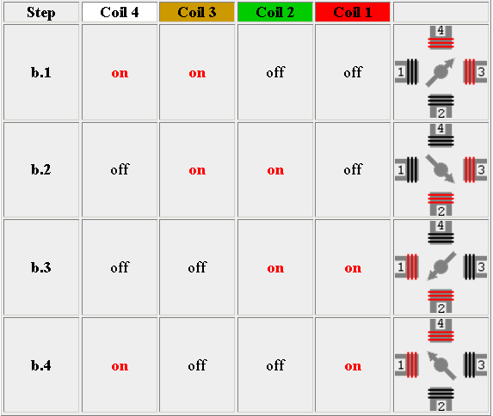
Two-Coil Excitation - Each successive pair of adjacent coils is energised in turn.

Slide 8
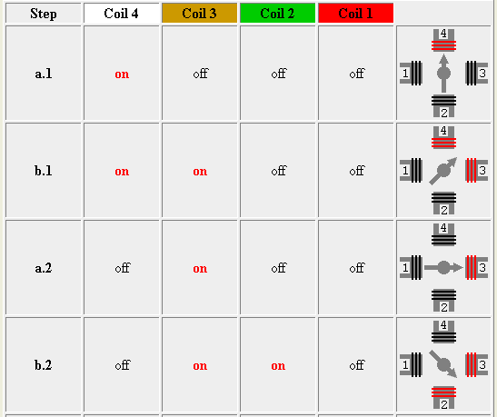
Interleaving the two sequences will cause the motor to half-step
8 step sequence = normal 4 step + wave drive 4 step.

Slide 9
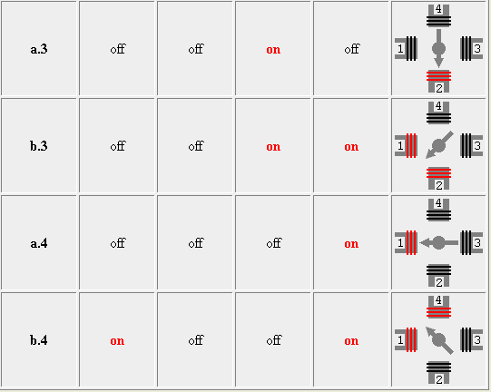

Slide 10


Single-Coil Excitation
Two-Coil Excitation
Interleaved Single- and Two-Coil Excitation
Half-Stepping

Slide 11
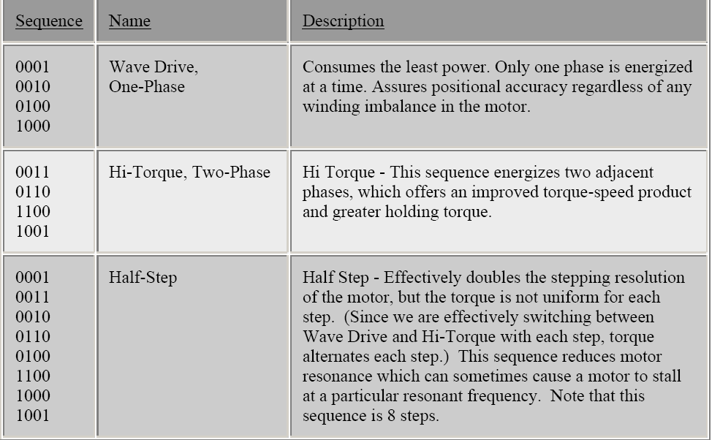

Slide 12
How Far Does It Move?
Step Angle
  Arc Through Which Motor Turns With ONE Step Change of the Windings
  Varies With Model of Stepper Motor
  (Depending on the number of teeth on stator and rotor)
  Normally in Degrees
  Step angle = 360/No. of Steps per Revolution
  Commonly available no. of steps per revolution are 500, 200, 180, 144, 72, 48, 24
Notes:
SBMJCE

Slide 13
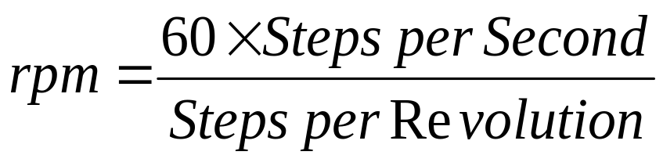
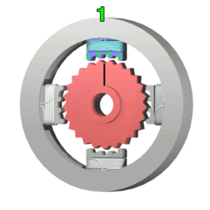
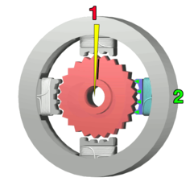
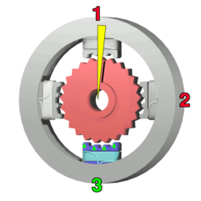
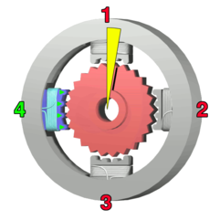
How Fast?
Revolutions per Minute (RPM)
The top electromagnet (1) is turned
on, attracting the nearest teeth of a
gear-shaped iron rotor. With the
teeth aligned to electromagnet 1,
they will be slightly offset from
electromagnet 2.
The top electromagnet (1)
is turned off, and the right
electromagnet (2) is
energized, pulling the
nearest teeth slightly to
the right. This results
in a rotation of 3.6° (1.8’)
in this example.
The bottom
Electromagnet (3)
is energized;
another 3.6° (1.8’)
rotation occurs.
The left electromagnet (4) is enabled,
rotating again by 3.6° (1.8’).
When the top electromagnet (1)
is again enabled, the teeth in the
sprocket will have rotated by
one tooth position; since there
are 25(50) teeth, it will take 100(200)
steps to make a full rotation in this example.
Notes:
SBMJCE

Slide 14
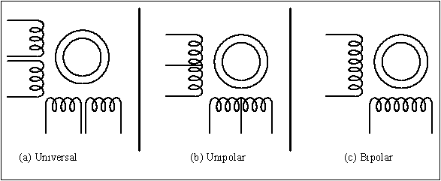
Common Stepper Motor Types
Notes:
SBMJCE

Slide 15
Drivers
May Need a Driver Circuit
  Same Problem as Relays – May Draw Too Much Current
Types
  Transistor Drivers
    Usually a Darlington Pair
  Darlington Arrays
  Can Build It Yourself
Notes:
SBMJCE

Slide 16
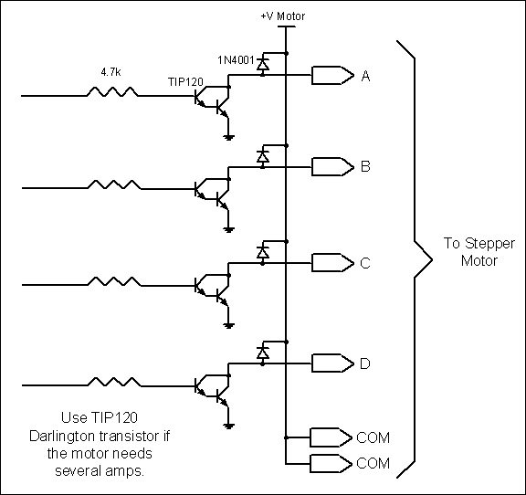
Using Transistors for Stepper Motor Driver
Notes:
SBMJCE

Slide 17
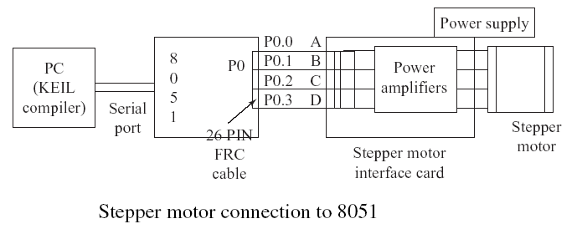
Applications:
Used in
In instrumentation such as watches, clocks, etc.
Computer peripherals such as card readers, teleprinters, teletypes,
dot matrix printers, etc.
Robotics

Slide 18
DC Motors
Only One Winding
Two Connections: + and –
Reversing Polarity Reverses Motor
Move Continuously
Cannot Determine Position
Notes:
SBMJCE

Slide 19
Characteristics:
RPM
  No Load: Maximum RPM With No Load on Shaft
    Given in Data Sheets
  Loaded: Actual Maximum When Loaded
    Not in Most Data Sheets
Voltage Range
  Speed Increases With Voltage on a Given Motor
Current Draw
  Data Sheet Rating Is With Nominal Voltage and No Load
  Increases With Load
Speed Decreases With Load
Notes:
SBMJCE

Slide 20
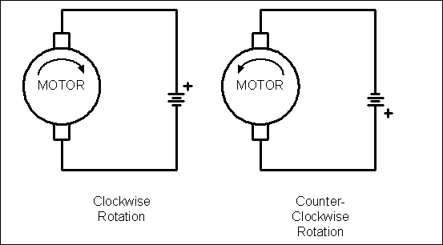
DC Motor Rotation (Permanent Magnet Field)
Notes:
SBMJCE

Slide 21
Bi-Directional Control
Can Change Polarity With a Little Work
H-Bridge Is Simplest Method
  Uses Switches (Relays Will do)
Notes:
SBMJCE

Slide 22
Controlling Speed
Speed Depends On
  Load
  Voltage
  Current
Can Control Power By Changing (Modulating) Width of Pulse to Motor
  Wider Pulse ➔ Faster Speed
  Narrower Pulse ➔ Slower Speed
Note: Doesn’t Work With AC Motors
  AC Motor Speed Depends on AC Frequency (CPS)
Notes:
SBMJCE

Slide 23
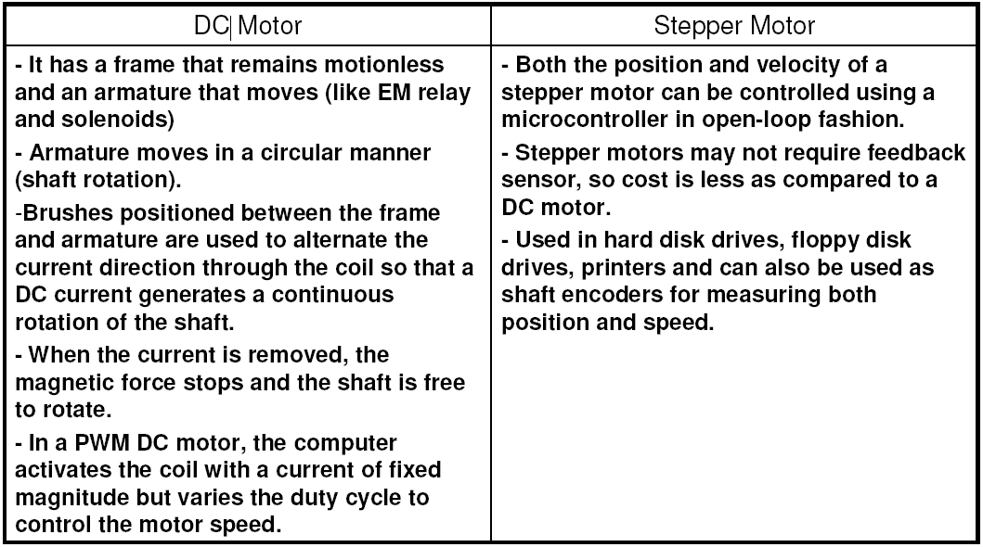

Slide 24
